Slide 1
Employee Data Analysis using Excel
STUDENT NAME: AKSHAYA N
REGISTER NO: 312216362 /asunm1621312216362
DEPARTMENT: B. COM COMPUTER APPLICATION
COLLEGE : SHRI SHAMKARLAL SUNDARBAI SHASUN JAIN COLLEGE FOR WOMEN

Slide 2
PROJECT TITLE
Employee Performance Analysis using Excel

Slide 3


AGENDA
Problem Statement
Project Overview
End Users
Our Solution and Proposition
Dataset Description
Modelling Approach
Results and Discussion
Conclusion
3/21/2024 Annual Review

Slide 4

PROBLEM STATEMENT
Effective employee performance analysis is critical for organizational success, but many companies struggle with managing and interpreting large volumes of performance data.
This project aims to leverage Excel data analytics to systematically analyze employee performance, identify key performance indicators (KPIs), and uncover actionable insights.
By doing so, the project seeks to enhance productivity, improve decision-making, and support the organization in achieving its business objectives.

Slide 5

PROJECT OVERVIEW
This project focuses on analyzing employee performance data using Excel's powerful data analytics tools. The goal is to identify key performance indicators (KPIs) and trends that impact productivity and overall organizational success. By processing and visualizing employee data, the project will provide actionable insights to improve decision-making, enhance employee performance, and support strategic business goals. The analysis will include data cleaning, KPI identification, trend analysis, and result interpretation to offer a comprehensive understanding of employee performance dynamics within the organization.

Slide 6

WHO ARE THE END USERS?
The primary end users of this employee performance analysis are:
HR Managers: To monitor employee performance, identify top performers, and address underperformance issues.
Team Leads and Supervisors: To gain insights into team productivity, guide performance improvement, and make informed decisions about training needs.
Senior Management: To align employee performance with organizational goals, optimize resource allocation, and support strategic planning.
Employees: To receive feedback on their performance and identify areas for personal and professional growth.

Slide 7

OUR SOLUTION AND ITS VALUE PROPOSITION
Our solution leverages Excel data analytics to systematically analyze employee performance data. By utilizing Excel's powerful tools, we clean, process, and visualize performance metrics to identify key performance indicators (KPIs), trends, and patterns. This data-driven approach enables more precise and informed decision-making.
Value Proposition:
Improved Decision-Making: Enables HR and management to make informed decisions based on actionable insights.
Enhanced Productivity: Identifies areas for improvement, helping to boost overall employee performance.
Cost-Effective: Uses readily available tools (Excel) without the need for expensive software, making it accessible and efficient.
Employee Development: Provides clear feedback and identifies growth opportunities, fostering employee engagement and development.

Slide 8
Dataset Description
Basic Information:
EmpID: Unique identifier for each employee.
FirstName: Employee's first name.
LastName: Employee's last name.
Business Unit:
BusinessUnit: The unit or department where the employee works. Examples include WBL, CCDR, BPC, MSC, and EW.
Employment Details:
EmployeeStatus: Current status of employment (Active).
EmployeeType: Type of employment (Full-Time, Contract, Part-Time).

Slide 9
Dataset Description
Classification:
EmployeeClassificationType: Employment classification, which includes Temporary or Full-Time.
Gender:
GenderCode: Gender of the employee (Female, Male).
Performance:
Performance Score: Rating of employee performance (Exceeds, Fully Meets).
Current Employee Rating: Numerical rating that corresponds to the performance score.
PERFORMANCE CATEGORY: The category assigned based on performance score and rating (HIGH, LOW, VERY HIGH, MEDIUM).

Slide 10

THE "WOW" IN OUR SOLUTION
=IFS(Z2>=5,"VERYHIGH",Z2>=4,"HIGH",Z2>=3,"MEDIUM",TRUE,"LOW")
The IFS formula streamlines employee performance analysis by automating the categorization of ratings into clear levels—"VERY HIGH", "HIGH", "MEDIUM", and "LOW". This enhances clarity, efficiency, and supports data-driven decisions, making performance evaluations straightforward and consistent.
10

Slide 11
MODELLING
1. Data Collection
Gathered raw employee performance data, including ratings, business unit information, employee status, and classification.
2. Data Cleaning
Removed inconsistencies, handled missing values, and ensured data accuracy.
3. Feature Collection
Selected key features such as performance score, employee status, and business unit for analysis.
Focused on variables that directly influence performance levels.
11

Slide 12
MODELLING
4. Performance Level Categorization
Used the IFS formula to categorize performance ratings into "VERY HIGH", "HIGH", "MEDIUM", and "LOW".
Ensured that the categorization aligns with organizational goals.
5. Data Analysis with Pivot Tables and Charts
Created pivot tables to summarize performance data across different dimensions (e.g., business units, employee types).
Developed charts to visualize performance distribution and trends.
12

Slide 13
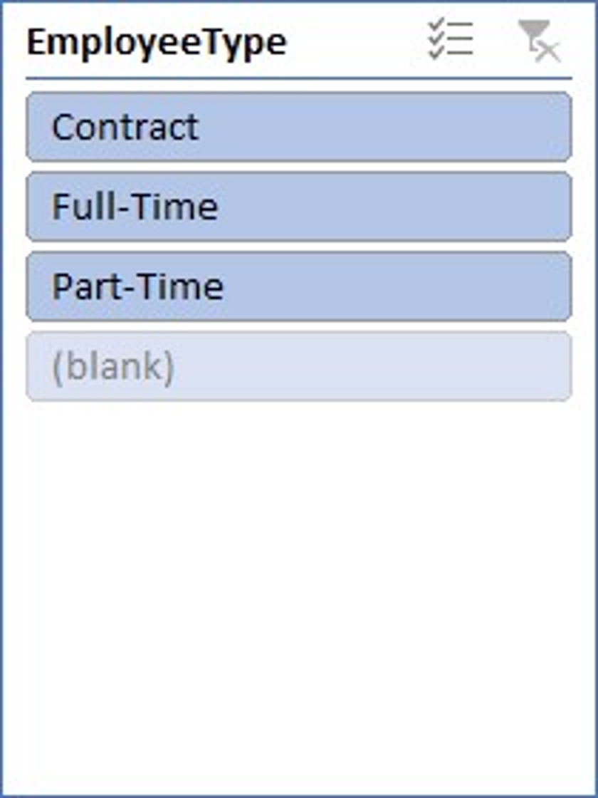
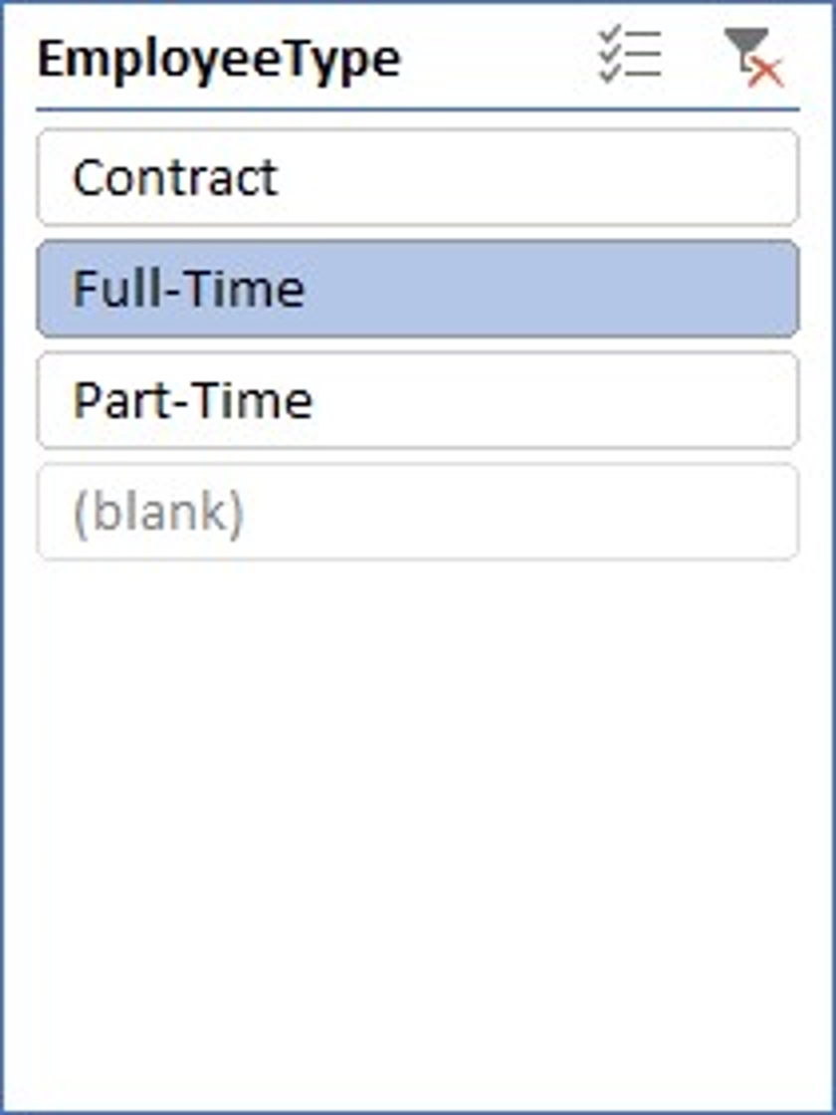
RESULTS
Count of FirstName | Column Labels
Row Labels | HIGH | LOW | MEDIUM | VERY HIGH | Grand Total
BPC | 37 | 80 | 152 | 34 | 303
CCDR | 45 | 89 | 141 | 25 | 300
EW | 41 | 78 | 160 | 23 | 302
MSC | 34 | 76 | 158 | 28 | 296
NEL | 50 | 73 | 158 | 23 | 304
PL | 50 | 68 | 151 | 32 | 301
PYZ | 44 | 85 | 146 | 24 | 299
SVG | 40 | 78 | 156 | 30 | 304
TNS | 38 | 75 | 160 | 24 | 297
WBL | 40 | 79 | 148 | 27 | 294
Grand Total | 419 | 781 | 1530 | 270 | 3000
GenderCode | (All)
Count of FirstName | Column Labels
Row Labels | HIGH | LOW | MEDIUM | VERY HIGH | Grand Total
BPC | 11 | 30 | 51 | 16 | 108
CCDR | 17 | 36 | 53 | 10 | 116
EW | 12 | 24 | 52 | 11 | 99
MSC | 10 | 27 | 60 | 9 | 106
NEL | 14 | 24 | 56 | 6 | 100
PL | 16 | 26 | 56 | 7 | 105
PYZ | 16 | 33 | 49 | 10 | 108
SVG | 13 | 26 | 44 | 13 | 96
TNS | 12 | 31 | 52 | 4 | 99
WBL | 17 | 23 | 56 | 5 | 101
Grand Total | 138 | 280 | 529 | 91 | 1038
13

Slide 14
RESULTS
14

Slide 15
RESULTS
15

Slide 16
Conclusion
The employee performance analysis project successfully streamlined data handling and evaluation processes.
Through careful data collection, cleaning, and the use of the IFS formula for categorization, we ensured clear and consistent performance assessments.
The creation of pivot tables and charts provided valuable insights into performance trends across various dimensions.
This approach enabled more informed, data-driven decisions, improving the organization’s ability to manage and develop its workforce strategically, and laying a solid foundation for continuous performance improvement.

